Slide 1

Printable Lawn Sign Graduation Announcement Instructions
Congrats Graduates!
Share your accomplishment!!
Use these 18x12” templates to create a lawn sign, and export for upload to our printing partner FastSigns.
Right click on all photos to “Change Picture” and enter your graduate’s name. See notes on each page for additional instructions.
Recommended use of ROBOTO fonts – should already be available in your updated version of Microsoft 365, or Arial as a back up.
See final slide 6 for other export instructions/tips.

Slide 2
Lawn Sign Grad Announcement 1

Slide 3
Lawn Sign Grad Announcement 2
Notes:
Click on the picture icon to add your custom photo
Insert your graduate’s name.

Slide 4
Lawn Sign Grad Announcement 3
Notes:
Click on the picture icon to add your custom photo

Slide 5

Lawn Sign Grad Announcement 4

Slide 6
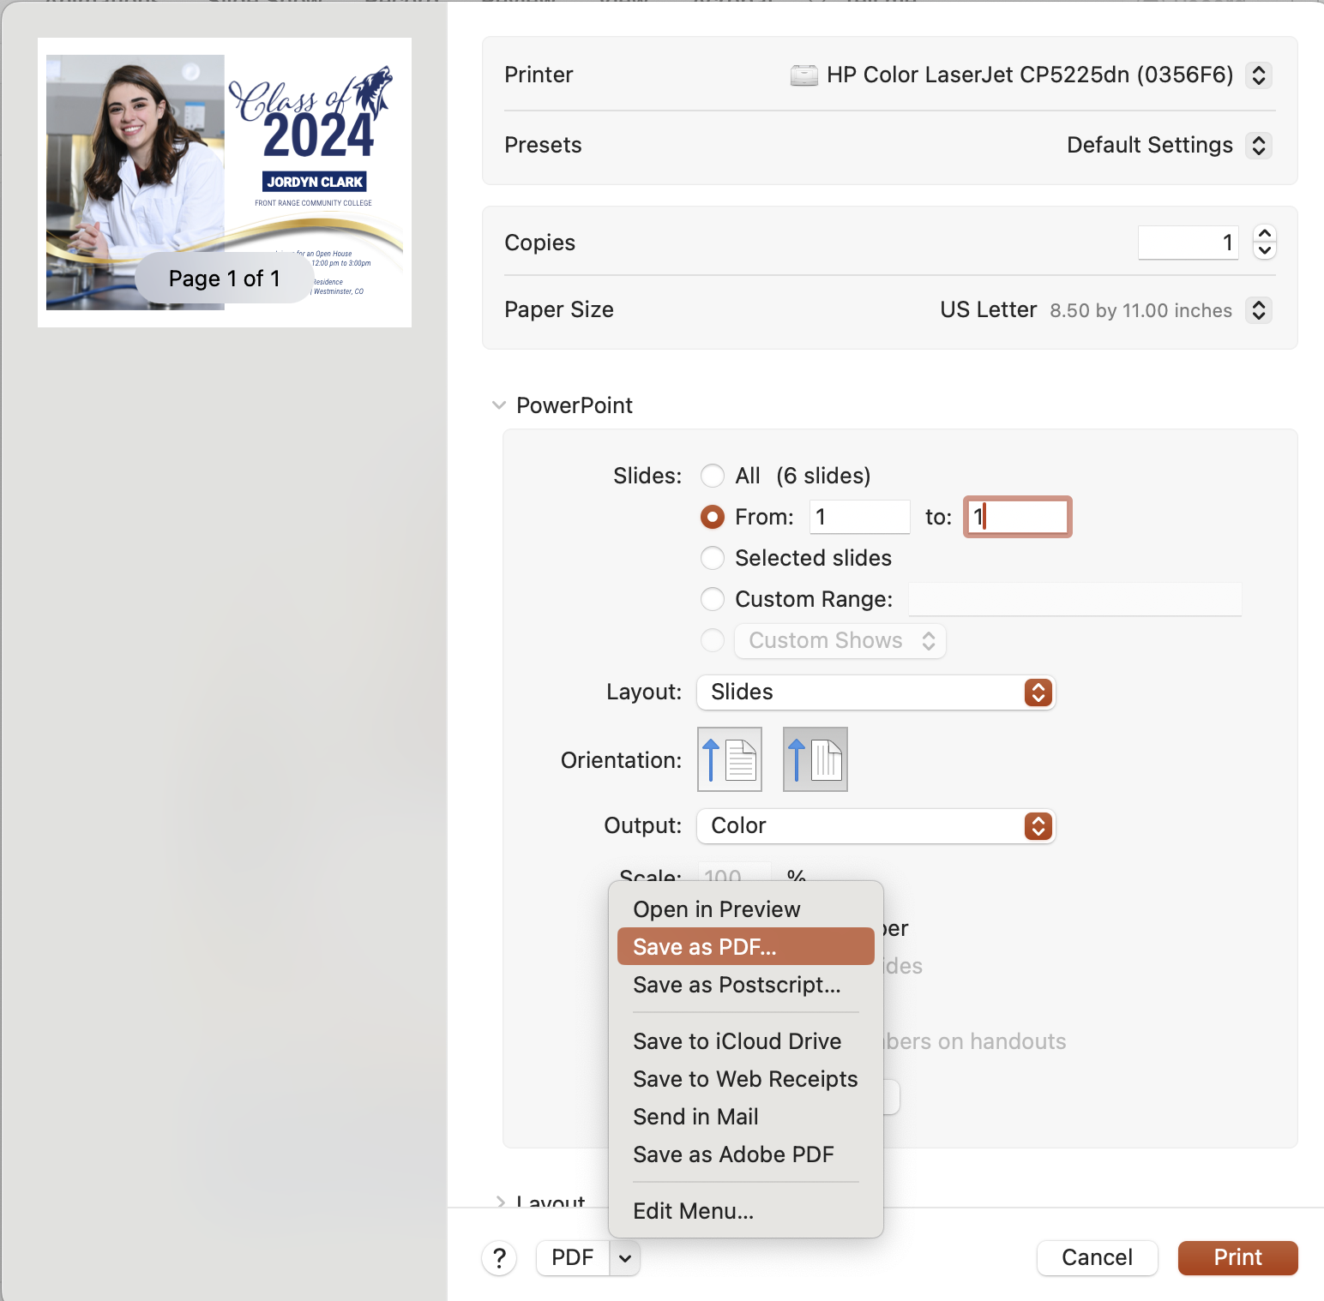
Export Instructions
To export:
On a MAC-
  File> Print
  In print dialogue box, indicate the slide you wish to print, From: x to x
  Click the PDF button in the bottom left, Save to PDF
  Make sure there is NO scaling, uncheck any box that says scale to fit.
On a PC
  https://www.youtube.com/watch?v=fg2JvYheg74&ab_channel=KevinStratvert
  Make sure there is NO scaling, uncheck any box that says scale to fit.

